Slide 1
Assembly for Primary Schools

Slide 2
Equality – Why is it important?
What happens in the video?
How did the children feel?
What did they do to try to make things equal?
What does the empty plate represent?
https://www.youtube.com/watch?v=oRnSdwCnxZo
Notes:
You may need to discuss the meaning of the word equality using examples that are important to them – e.g. food, playtime, attention from teachers and friends ….
This Oxfam video introduces the theme of equality and fairness. How does inequality make people feel – and what can the consequences be?

Slide 3
Equality for Girls: True or False?
Women produce up to 80% of the food in developing countries but own less than 25% of farming land.
In developing countries one in three girls get married before reaching their 18th birthday.
In the world’s 10 poorest countries 9 out of 10 girls haven’t completed school.
Approximately 70% of the people in minimum wage jobs in the UK are women.
In Wales only 28% of local councillors, 18% of Council Leaders and 27% of Cabinet Members are women.
In the 20 since devolution in Wales there hasn’t been one Assembly Member who was female, a woman of colour and from an ethinc minority.
Notes:
Introduce these statements one at a time. Are they true or false?
As it happens, they are all true. Are some more surprising that others? What does this say about the status of women in Wales and beyond?

Slide 4
Why is this important?
Countries that treat men and women more equally produce more women who are leaders and scientists.
Countries who treat the two sexes more equally win more medals in the Olympic Games.
Girls who receive an education tend to marry later and have less children who are more healthy.
Girls who receive an education earn more and can support their families better.
Notes:
You could show the title first, and ask the pupils why they think it’s important to treat boys and girls equally – then show the evidence.
The main message is: When girls receive equal rights, they are not the only ones to benefit, but society as a whole.
If there is time you could also look at this short USAid video about why it’s important to empower girls: https://www.youtube.com/watch?v=wPkHFQWVw4o

Slide 5
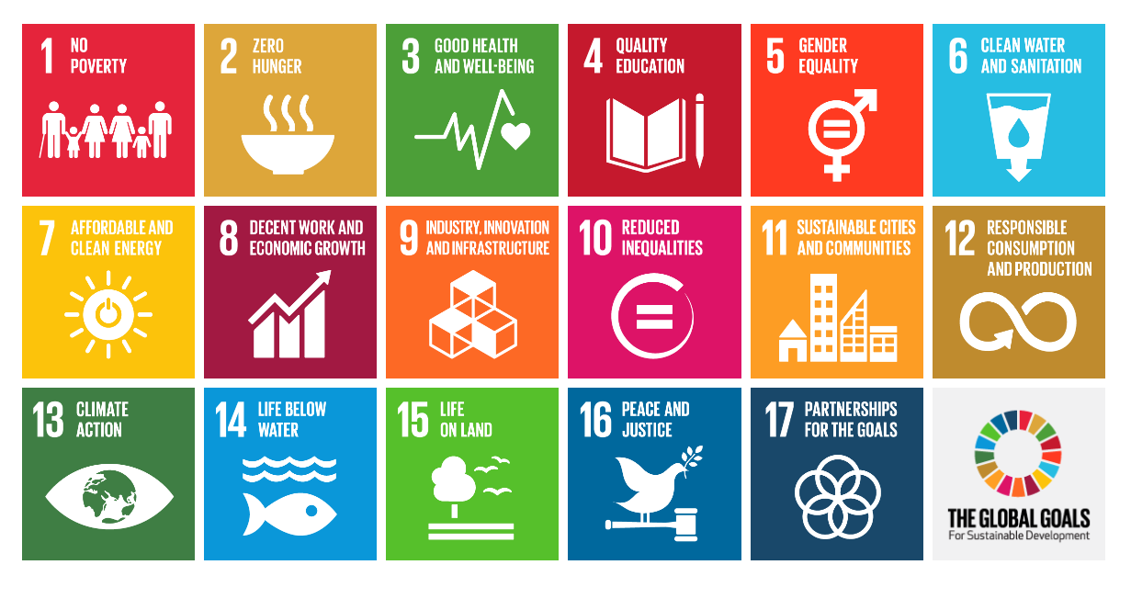
Sustainable Development Goals
Notes:
What are these? A set of world-wide development goals which 193 countries agreed upon in 2015 in order to create a better and more sustainable world. These countries have agreed to aim to reach these 17 goals by 2030.
Which goal directly relates to women’s equality? (5) Which other goals would it be easier to achieve if there were more equality between women and men? (The most obvious ones are 1, 2, 3, 4, 8 and 10).

Slide 6
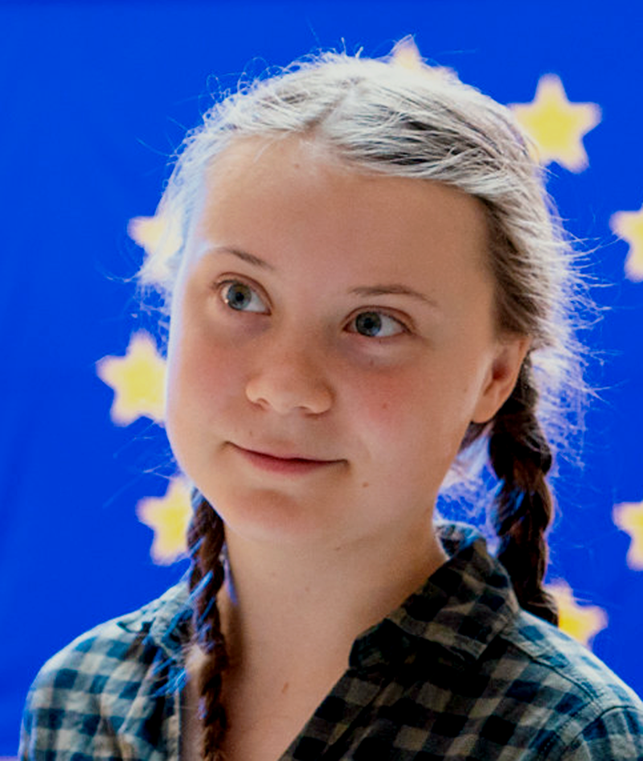
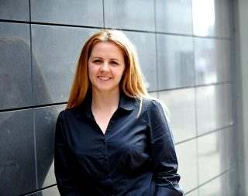
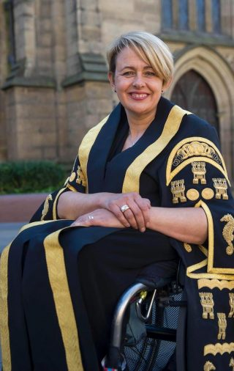
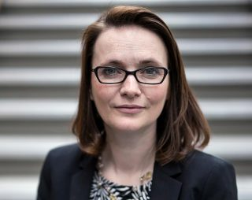
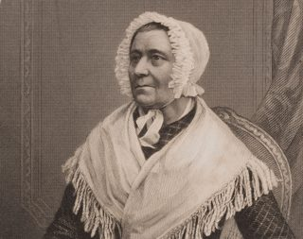
So why is equality important?
g.
c.
e.
a.
b.
f.
d.
Notes:
Another reason why equality is important. When women have equal opportunities, they can do amazing things for society.
Here are just some examples. Can you name some of them?
a. Malala Yousafzai – campaigner for girls’ rights – especially the right to education
b. Tanni Grey-Thompson – para-olympian, TV presenter and member of the House of Lords
c. Beti Campbell – the first black Headteacher in Wales
d. Betsi Cadwaladr – she worked as a nurse alongside Florence Nightingale in the Crimea – also on board ships
e. Hayley Gomez – international expert on astro-physics
f. Kirsty Williams – politician; Secretary of State for Education in the Welsh Assembly
g. Greta Thunberg – campaigner for the environment
There are 100 examples of extraordinary women on WEN Cymru’s website here: http://www.100menywodcymreig.cymru/

Slide 7
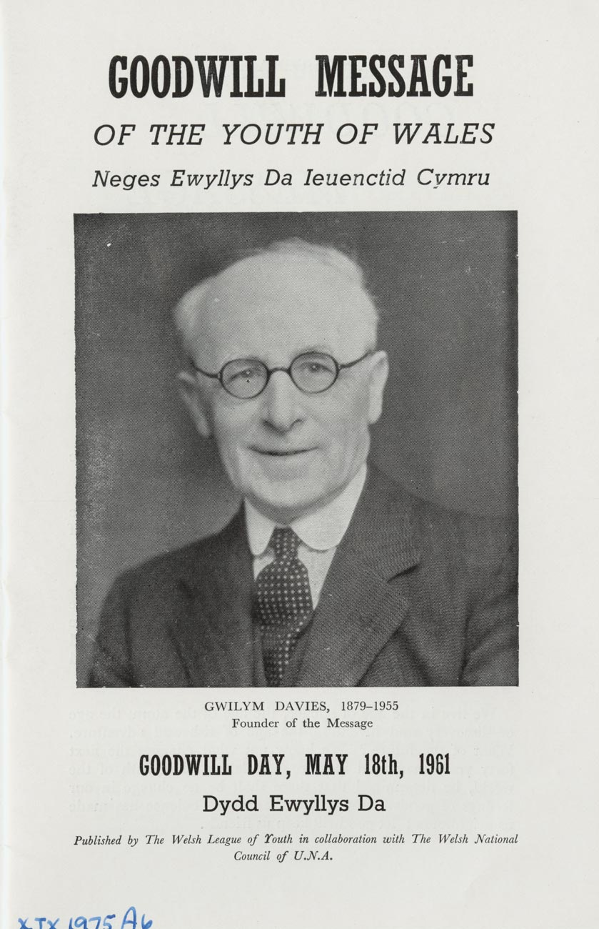
The Message of Peace and Goodwill
A unique piece of Wales’ peace heritage
Inspired by Reverend Gwilym Davies from the Rhymney Valley
Sent for the first time in 1922 – and every year since then without a break
An opportunity for young people in Wales to express their opinion about things that are important to them and to connect with other young people worldwide.
Notes:
Something of the Message’s History:
It was first sent by the Revd Gwilym Davies from the Rhymney Valley. He was a pacifist and prominent in establishing the Welsh League of Nations Union and UNESCO. He believed in bringing together the children of the world. The founder of the Urdd, Syr Ifan ab Owen Edwards, decided to support the campaign to help promote understanding and eradicate prejudice.
The Message was first broadcast by the BBC World Service in 1924 and today it is broadcast and shared in a number of different languages, reaching every corner of the globe through social media.
After supporting it since its inception, in the 1950's the Urdd was given the responsibility of creating and announcing the Message of Peace and Goodwill from the young people of Wales.
By 1935, 68 countries had responded. Even during the Second World War the message was broadcast without fail, and following the war heart-rending messages were received from children in Germany and Japan.

Slide 8
What can we do to empower girls?
On International Women’s Day – 8th March:
Make a pledge – anything to support women’s equality – and share it on social media with the hashtag #IWD2020
Organise an event – e.g. a café, book fayre, a speaker, an exhibition, a film or drama
Notes:
International Women’s Day is held every year on 8th March – an opportunity to celebrate girls’ achievements worldwide and to campaign for equality.
Here are some ideas for activities.
See the WEN Wales website for more ideas: https://wenwales.org.uk/cy/amdanom-rhcm/
Image shows an event held by Oxfam on International Women’s Day 2015 in Kumala, Sierra Leone.
Image: Michelle Curran/Oxfam

Slide 9
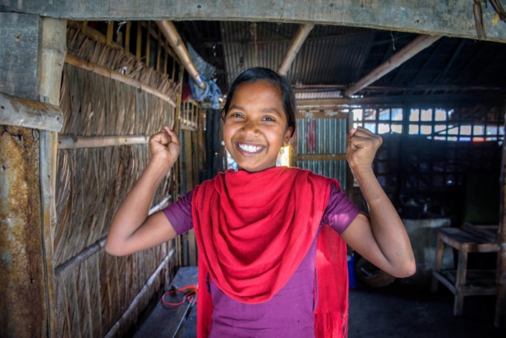
What else can we do to empower girls?
Choose a theme that’s important to to you – e.g. the lack of education for girls; early marriage
What about getting creative and producing your own story or film – and sharing it with others?
You can find other suggestions on World Vision’s website
On Saturday 16th May you can organise a 6 kilometre walk – the distance many women walk to fetch clean water.
Notes:
Here are some things pupils can start doing now to raise awareness of the Message and to take action. Tell them that they will be taking part in further activities about empowering girls in the coming weeks, and encourage them to start thinking how they would like to respond to the theme – e.g. through creating a story or film; holding an event in the school and inviting a celebrity ………
More suggestions are available on World Vision’s web site here: https://www.worldvision.org/gender-equality-news-stories/seven-ways-empower-women-girls

Slide 10
How can you be part of the Urdd’s Message of Peace and Goodwill in 2020?
Share your work on empowering girls with others!
Share with the Urdd - @Urdd @Urddgobaithcymru using #Heddwch2020
Share the Message with as many people as you can on 18th May, 2020 – especially children in the UK and in other parts of the world!
#Heddwch2020
heddwch@urdd.org
Notes:
Tell them that the video of the Message of Peace and Goodwill will be shared on 18th May, 2020, using the hashtag #heddwch2020 – an opportunity to respond and to share the Message with others!
You can also aim to share the Message with children in other countries, and encourage them to send responses. Ask the children to think of ideas - e.g. do you have a link with a school in a different country?

