Slide 1


The Urdd Peace and Goodwill Message 2019
VOICE
Assembly for Primary Schools

Slide 2
The United Nations Convention on the Rights of the Child (UNCRC)
The right to be safe
We have the right to protection from violence, abuse and neglect (Article 19)
If there is war, we have the right to be safe and not be forced to become soldiers (Article 38)
We have the right to express our views and to have our views heard (Article 12)

Slide 3
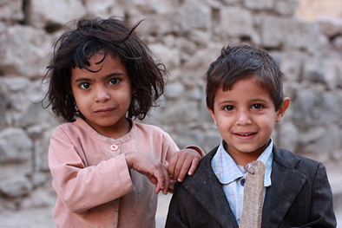
The United Nations Convention on the Rights of the Child (UNCRC)
The right to be safe
When there is war, children can lose their access to other rights such as:
Food, clothes and a safe place to live (Article 27)
Education (Article 28)
Culture and language (Article 30)
Play and leisure (Article 31)
The right to be free from all types of abuse (Articles 32, 34, 36 a 37)
Children in Sanaa, the capital of Yemen
Wikimedia Commons

Slide 4
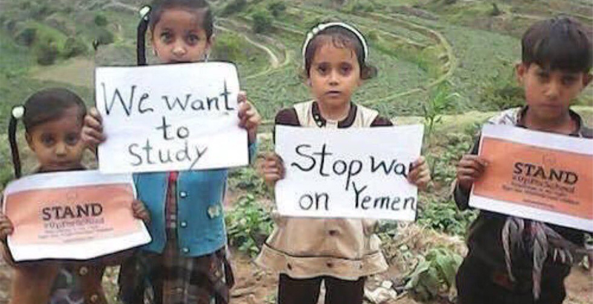
War in Yemen – how Children are suffering
Salah’s story
Listen to Salah’s story here: www.bbc.co.uk/newsround/46446478
What has happened to Salah and his family due to the war?
What rights does he not have now?
How does he spend his time now – and why?
In times of war, innocent people often suffer most – including children.

Slide 5
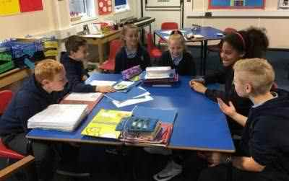
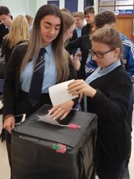
What can we do?
We can use our VOICE to…….
Organize an event in the school or the local community to raise money to help children in Yemen.
Write a letter to a local newspaper or hold a radio interview to raise awareness about the suffering of Yemen’s children due to the war.
Plan a campaign to put pressure on the UK government to stop selling arms to Saudi Arabia and to use its influence to encourage people to sit down together to discuss peace.

Slide 6

The Urdd Peace and Goodwill Message 2019

Slide 7
Responding to the Message – some Creative Ideas
You can….
Draw pictures in response to Salah’s story and other children like him using the hashtag #heddwch2019 and use them to create a display in your school. (Other stories are available here: www.unicef.ca/en/blog/yemen-childs-story)
Create a film to raise awareness of the children’s situation in Yemen; try to use some of children’s own voices.
Use the hashtag #heddwch2019 and share what you have created with the Urdd using heddwch@urdd.org.

