Slide 1


The Urdd’s Message of Peace and Goodwill 2019
VOICE
Assembly for Secondary Schools

Slide 2
The United Nations Convention on the Rights of the Child (UNCRC)
The right to be safe
We have the right to protection from violence, abuse and neglect (Article 19)
If there is war, we have the right to be safe and not be forced to become soldiers (Article 38)
We have the right to express our views and to have our views heard (Article 12)

Slide 3
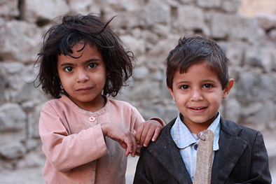
The United Nations Convention on the Rights of the Child (UNCRC)
The right to be safe
When there is war, children can lose their access to other rights such as:
Food, clothes and a safe place to live (Article 27)
Education (Article 28)
Culture and language (Article 30)
Play and leisure (Article 31)
The right to be free from all types of abuse (Articles 32, 34, 36 a 37)
Children in Sanaa, capital of Yemen
Wikimedia Commons

Slide 4
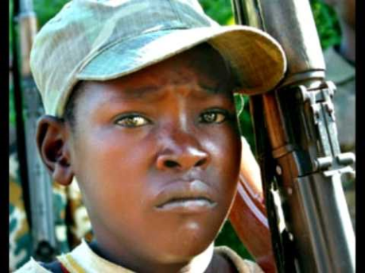
Children used as soldiers…..
Watch the video, then consider:
How do the images in the video make you feel?
How does being a soldier affect the children, in your opinion?
Which rights do they lose by becoming soldiers?
Who should protect them?
What can we do to help them?
www.youtube.com/watch?v=6sFi5c7uGB4

Slide 5
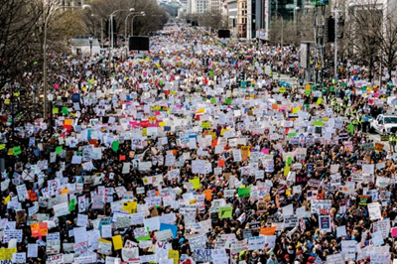
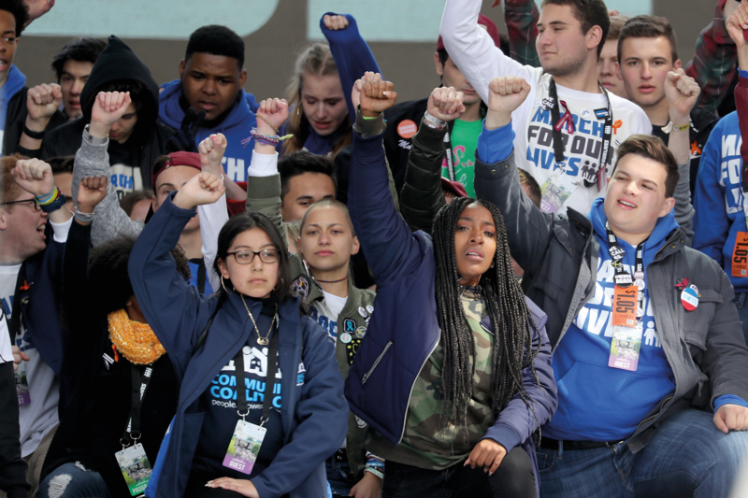
What can young people do against violence?
The story of students at Marjory Stoneman Douglas High School, Parkland, Florida

Slide 6
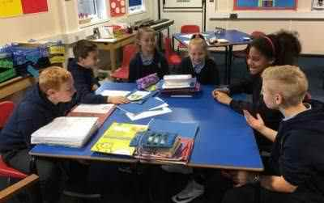
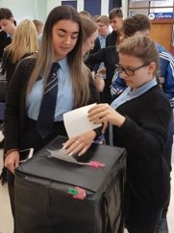
What can we do?
We can use our VOICE to…….
Organize an event in the school or the local community to raise awareness about children who are recruited as child soldiers, and to raise money for a charity trying to help them.
Write a letter to a local newspaper or hold a radio interview to raise awareness about children who are suffering due to war, including children recruited as child soldiers.
Write to your Member of Parliament asking the British Government to raise the minimum age of recruitment for the armed forces to 18.

Slide 7

The Urdd Peace and Goodwill Message 2019

Slide 8
Responding to the Message – some Creative Ideas
You can….
Draw pictures or write in response to the stories of children who are suffering due to violence and war, using the hashtag #heddwch2019 and use them to create a display in your school.
Create a film to raise awareness of children who are recruited as child soldiers, or children who are suffering due to war like the war in Yemen. (See: www.unicef.ca/en/blog/yemen-childs-story)
Use the hashtag #heddwch2019 and share what you have created with the Urdd using heddwch@urdd.org.

